Slide 1
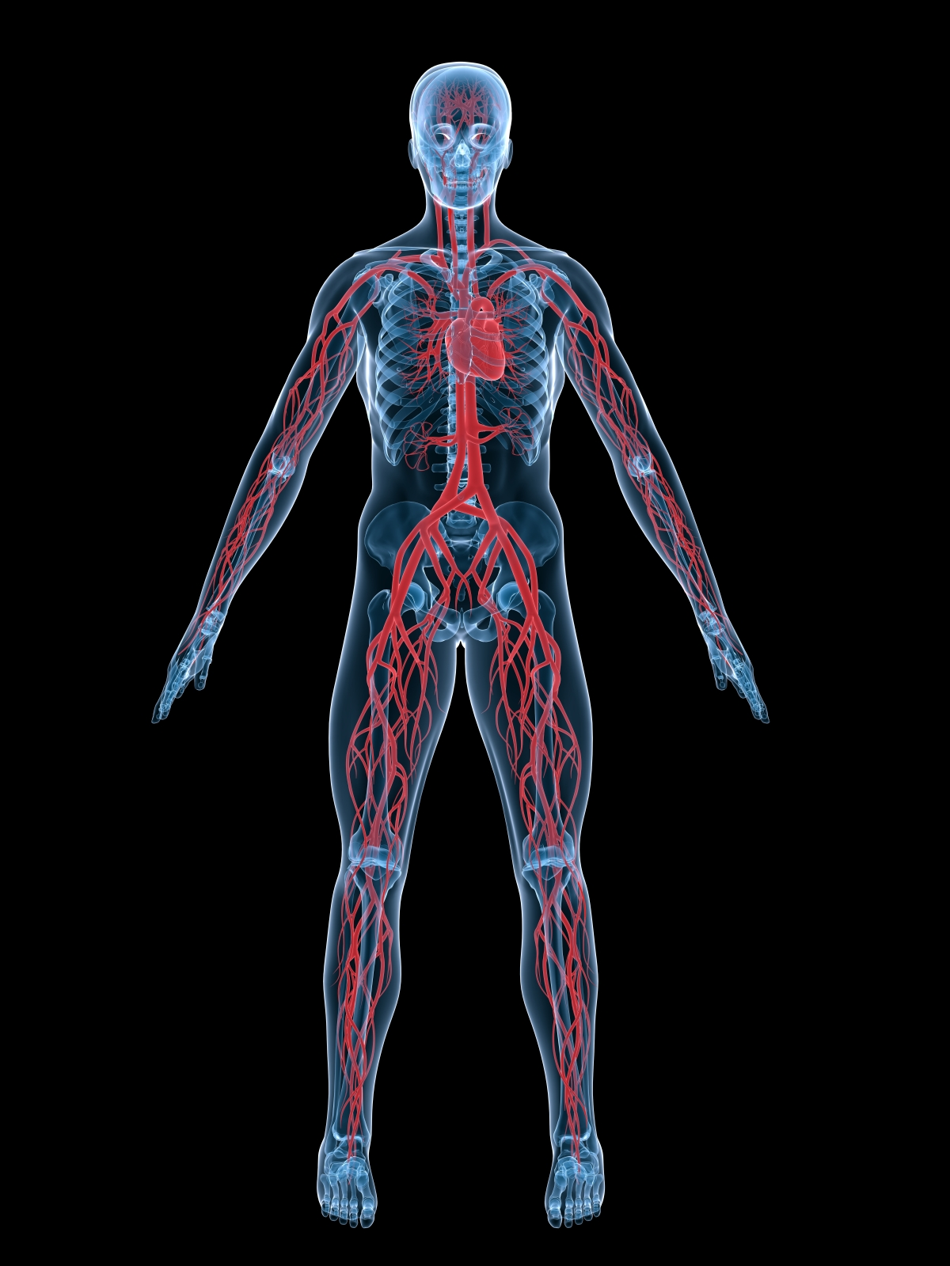
Circulatory System
Brought to you by: Zachary O’Mell

Slide 2
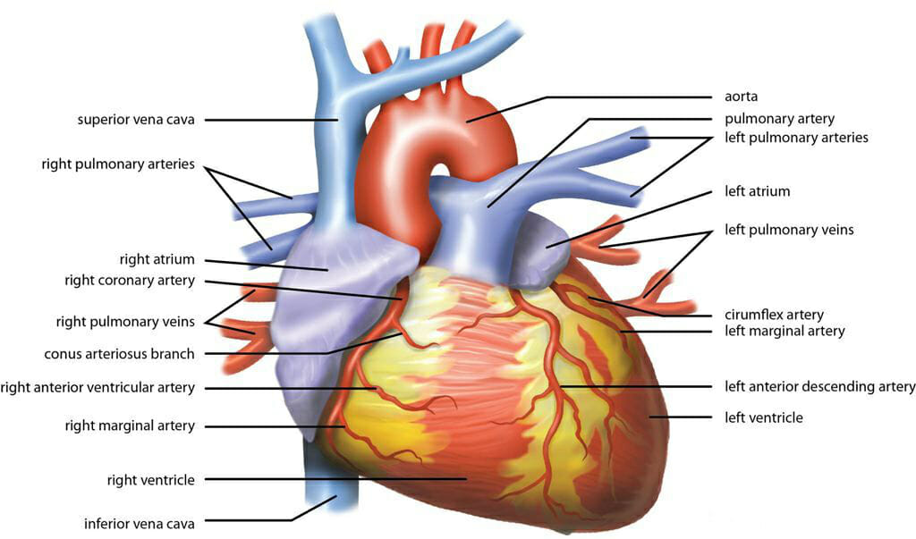
Circulatory system within the human body
Your blood runs throughout the body
The arteries run throughout every part of your body; brain, arms, legs, torso
The heart is the center of the circulatory system where all blood travels through

Slide 3
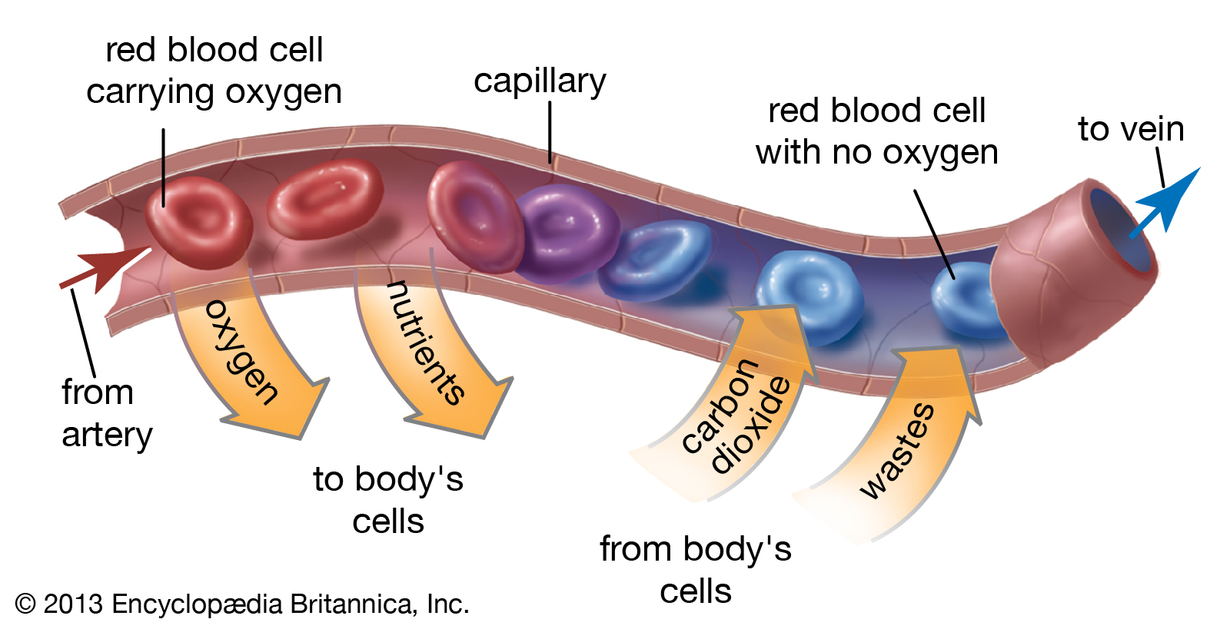
What does the circulatory system look like?
All of the blood from the right side of your heart goes into your lungs
The blue are veins which return de-oxygenated blood to the heart
The red are arteries that deliver the oxygenated blood to the rest of your body

Slide 4
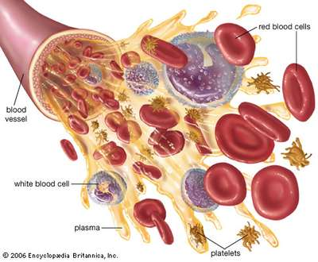
What is the main purpose of the circulatory system?
One of the main purposes is to bring; oxygen, nutrients, and hormones to your body’s cells
Another purpose is to remove cell wastes and regulate body temperatures
It also delivers blood through arteries to keep your body moving

Slide 5
How does the circulatory system work with other systems to keep homeostasis inside your body?
It works with almost all systems because it delivers blood to all of your trillions of cells
Inside all of that blood you have oxygen and nutrients that your body needs to survive
Most importantly it delivers blood to the brain so it can send out messages to the rest of the body

Slide 6
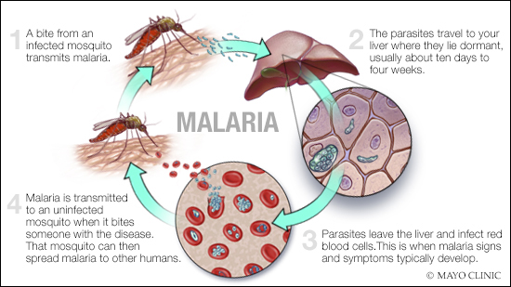
Are there any diseases or disorders associated with the circulatory system?
Heart Disease
Hypertension
Peripheral Vascular Disease
Stroke
Malaria

Slide 7
Are there any rick factors or environmental influences that can possibly harm the organ system?
You can split this into two categories
Modifiable | Non-modifiable
All tobacco related products High blood pressure High cholesterol Stress Diabetes | Race Age Gender Family history

Slide 8
What are the symptoms of possible Issues in the system? If so, are there treatments?
Issue | Symptoms | Treatment
Peripheral Vascular Disease | Numbness, Tingling, Pain | Surgery, Specific Medicine
Heart Attack | Chest Pain, Shortness of Breath | Heart Catheterization, a Stent, and/or surgery
Stroke | Left side Numbness | Immediate Medication

Slide 9
Can any organs be system be transplanted? Can you live without and organs?
Heart transplant
There is one other transplant that you could do called a blood transfusion
You can not live without your; heart, arteries, or your blood.

Slide 10
Where I got all of my info
I got a lot of information from my Mom who is a Manager of Cardio Pulmonary at Ascension Providence Hospital.
https://www.webmd.com/cancer/lymphoma/blood-disorder-types-and-treatment#2
https://www.reference.com/article/symptoms-heart-attack-men-98cda02138f23fd7?aq=a+heart+attack&qo=cdpArticles

